Slide 1
#7 Report a Crime or Emergency
Level 1-2
EL Civics

Slide 2
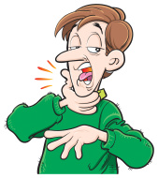
1.
Help! Fire.
Help! A boy is choking.
Help! A girl drank poison.
Help! Accident.

Slide 3
1.
No. Click here to try again.
Help! Fire.
Help! A boy is choking.
Help! A girl drank poison.
Help! Accident.

Slide 4
1.
Help! Fire.
Help! A boy is choking.
Help! A girl drank poison.
Help! Accident.
No. Click here to try again.

Slide 5
1.
Help! Fire.
Help! A boy is choking.
Help! A girl drank poison.
Help! Accident.
No. Click here to try again.

Slide 6
1.
Help! Fire.
Help! A boy is choking.
Help! A girl drank poison.
Help! Accident.

Slide 7
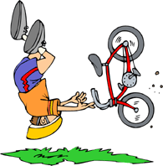
2.
Help! Fire.
Help! A boy is choking.
Help! A girl drank poison.
Help! Accident.

Slide 8
2.
No. Click here to try again.
Help! Fire.
Help! A boy is choking.
Help! A girl drank poison.
Help! Accident.

Slide 9
2.
Help! Fire.
Help! A boy is choking.
Help! A girl drank poison.
Help! Accident.
No. Click here to try again.

Slide 10
2.
Help! Fire.
Help! A boy is choking.
Help! A girl drank poison.
Help! Accident.
No. Click here to try again.

Slide 11
2.
Help! Fire.
Help! A boy is choking.
Help! A girl drank poison.
Help! Accident.

Slide 12
3.
Help! Fire.
Help! A boy is choking.
Help! A girl drank poison.
Help! Accident.

Slide 13
3.
Help! Fire.
Help! A boy is choking.
Help! A girl drank poison.
Help! Accident.

Slide 14
3.
Help! Fire.
Help! A boy is choking.
Help! A girl drank poison.
Help! Accident.
No. Click here to try again.

Slide 15
3.
Help! Fire.
Help! A boy is choking.
Help! A girl drank poison.
Help! Accident.
No. Click here to try again.

Slide 16
3.
Help! Fire.
Help! A boy is choking.
Help! A girl drank poison.
Help! Accident.
No. Click here to try again.

Slide 17
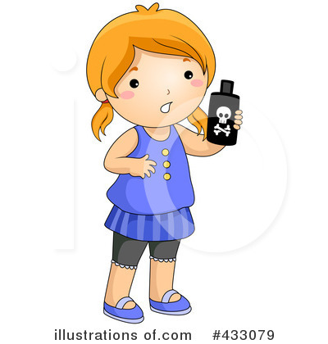
4.
Help! Fire.
Help! A boy is choking.
Help! A girl drank poison.
Help! Accident.

Slide 18
4.
Help! Fire.
Help! A boy is choking.
Help! A girl drank poison.
Help! Accident.
No. Click here to try again.

Slide 19
4.
Help! Fire.
Help! A boy is choking.
Help! A girl drank poison.
Help! Accident.
No. Click here to try again.

Slide 20
4.
Help! Fire.
Help! A boy is choking.
Help! A girl drank poison.
Help! Accident.

Slide 21
4.
Help! Fire.
Help! A boy is choking.
Help! A girl drank poison.
Help! Accident.
No. Click here to try again.

Slide 22
5. Spell your last name, please.
Help! Fire.
Elma Lopez
L-O-P-E-Z
318 Armstrong Street

Slide 23
5. Spell your last name, please.
Help! Fire.
Elma Lopez
L-O-P-E-Z
318 Armstrong Street
No. Click here to try again.

Slide 24
5. Spell your last name, please.
Help! Fire.
Elma Lopez
L-O-P-E-Z
318 Armstrong Street
No. Click here to try again.

Slide 25
5. Spell your last name, please.
Help! Fire.
Elma Lopez
L-O-P-E-Z
318 Armstrong Street

Slide 26
5. Spell your last name, please.
Help! Fire.
Elma Lopez
L-O-P-E-Z
318 Armstrong Street
No. Click here to try again.

Slide 27
6. What’s the address?
Help! Fire.
Elma Lopez
L-O-P-E-Z
318 Armstrong Street

Slide 28
6. What’s the address?
Help! Fire.
Elma Lopez
L-O-P-E-Z
318 Armstrong Street
No. Click here to try again.

Slide 29
6. What’s the address?
Help! Fire.
Elma Lopez
L-O-P-E-Z
318 Armstrong Street
No. Click here to try again.

Slide 30
6. What’s the address?
Help! Fire.
Elma Lopez
L-O-P-E-Z
318 Armstrong Street
No. Click here to try again.

Slide 31
6. What’s the address?
Help! Fire.
Elma Lopez
L-O-P-E-Z
318 Armstrong Street

Slide 32
7. 911 Operator.
Help! Fire.
Elma Lopez
L-O-P-E-Z
318 Armstrong Street

Slide 33
7. 911 Operator.
Help! Fire.
Elma Lopez
L-O-P-E-Z
318 Armstrong Street

Slide 34
7. 911 Operator.
Help! Fire.
Elma Lopez
L-O-P-E-Z
318 Armstrong Street
No. Click here to try again.

Slide 35
7. 911 Operator.
Help! Fire.
Elma Lopez
L-O-P-E-Z
318 Armstrong Street
No. Click here to try again.

Slide 36
7. 911 Operator.
Help! Fire.
Elma Lopez
L-O-P-E-Z
318 Armstrong Street
No. Click here to try again.

Slide 37
8. What is your name?
Help! Fire.
Elma Lopez
L-O-P-E-Z
318 Armstrong Street

Slide 38
8. What is your name?
No. Click here to try again.
Help! Fire.
Elma Lopez
L-O-P-E-Z
318 Armstrong Street

Slide 39
8. What is your name?
Help! Fire.
Elma Lopez
L-O-P-E-Z
318 Armstrong Street

Slide 40
8. What is your name?
Help! Fire.
Elma Lopez
L-O-P-E-Z
318 Armstrong Street
No. Click here to try again.

Slide 41
8. What is your name?
Help! Fire.
Elma Lopez
L-O-P-E-Z
318 Armstrong Street
No. Click here to try again.

Slide 42
9. Is anyone in the building?
Help! Fire.
Elma Lopez
I don’t know.
318 Armstrong Street

Slide 43
9. Is anyone in the building?
Help! Fire.
Elma Lopez
I don’t know.
318 Armstrong Street
No. Click here to try again.

Slide 44
9. Is anyone in the building?
Help! Fire.
Elma Lopez
I don’t know.
318 Armstrong Street
No. Click here to try again.

Slide 45
9. Is anyone in the building?
Help! Fire.
Elma Lopez
I don’t know.
318 Armstrong Street

Slide 46
9. Is anyone in the building?
Help! Fire.
Elma Lopez
I don’t know.
318 Armstrong Street
No. Click here to try again.

Slide 47
10. Is the boy conscious?
Help! A boy drank poison.
312 Orange Street
No.
M-E-I

Slide 48
10. Is the boy conscious?
Help! A boy drank poison.
312 Orange Street
No.
M-E-I
No. Click here to try again.

Slide 49
10. Is the boy conscious?
Help! A boy drank poison.
312 Orange Street
No.
M-E-I
No. Click here to try again.

Slide 50
10. Is the boy conscious?
Help! A boy drank poison.
312 Orange Street
No.
M-E-I

Slide 51
10. Is the boy conscious?
Help! A boy drank poison.
312 Orange Street
No.
M-E-I
No. Click here to try again.

